Slide 1

AGE 310: Instrumentation and Measurements
Lecture 1: Introduction & Basic Concepts
Instructor: Dr. Kadeghe G. Fue
Department of Agricultural Engineering
Sokoine University of Agriculture (SUA)

Slide 2

Welcome to AGE 310
This course bridges the gap between physical agricultural systems and the data we need to manage them.
Lecture Objectives:
Define "Instrumentation" and "Measurement".
Understand the Generalized Measurement System (GMS).
Differentiate between Static and Dynamic characteristics.
Analyze Types of Errors and Calibration.

Slide 3


Defining the Core Concepts
What is Instrumentation?
What is Measurement?
Instrumentation is the engineering science of measurement and control. It involves the study, design, manufacture, and usage of instruments to monitor physical variables in agricultural systems.
Measurement is the quantitative comparison of a physical quantity (the measurand) against a predefined standard.

Slide 4
"If you cannot measure it, you cannot improve it."
— Lord Kelvin
In Precision Agriculture, data is our most valuable crop. Without accurate measurement, we are just guessing.

Slide 5

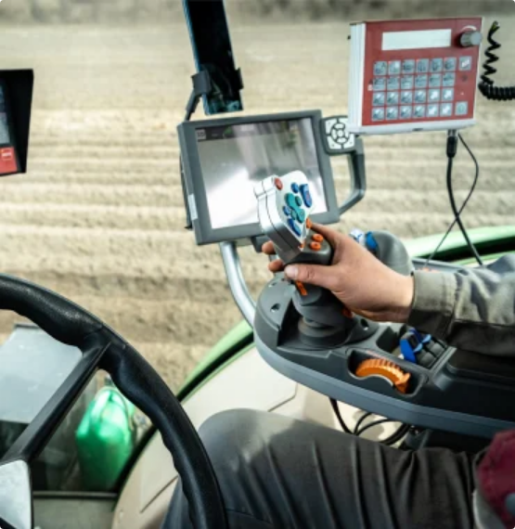
Significance in Agricultural Engineering
Why is this vital for an Agricultural Engineer?
Machine Performance: Real-time monitoring of engine RPM, torque, and fuel consumption (as seen in the modern dashboard).
Research: Validating crop models and soil physics theories.
Automation: Sensors drive the feedback loops in smart irrigation and robotic harvesting.
Commerce: Ensuring fair trade through accurate weighing.

Slide 6
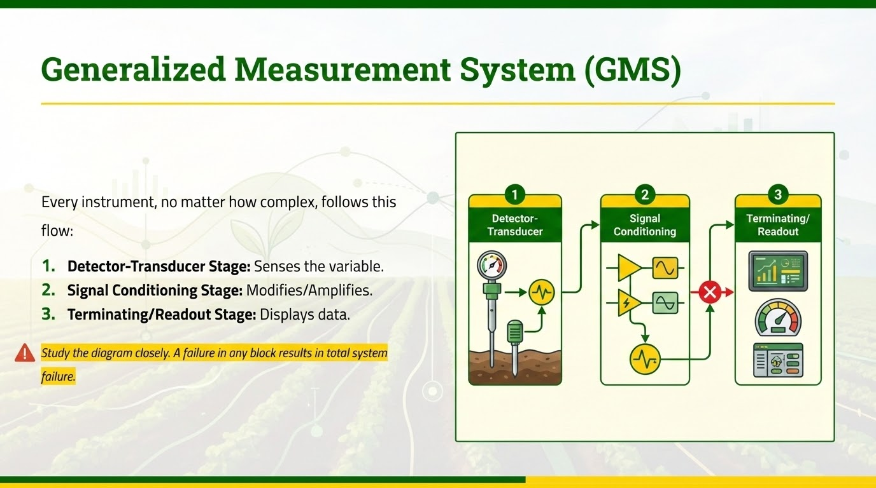

Slide 7
Stage 1: Detector-Transducer Element
The Sensor
The Transducer
The primary sensing element. It is the interface between the instrument and the physical world.
Converts the physical energy (mechanical, thermal, etc.) into a more usable form, typically an electrical signal.
Example: A strain gauge attached to a plow beam to measure draft force.
Goal: Faithful energy conversion with minimal loss.

Slide 8







Stage 2: Signal Conditioning Element
Raw sensor data is often "messy." We must clean it up before presentation.
Amplification
Filtering
A/D Conversion
Boosting weak millivolt signals to useable voltage levels.
Removing electrical noise (50Hz hum) or vibration.
Digitizing analog signals for computer processing.

Slide 9
Stage 3: Terminating Stage
Presentation
Control Integration
The user interface.
In modern agriculture, the "readout" is often an input for another machine.
Analog: Pointers, fluid columns (manometers).
Example: A soil moisture reading triggers a solenoid valve to open for irrigation.
Digital: 7-segment displays, LCD screens.
Graphical: Plotters, screen charts.

Slide 10






Classification of Instruments
Active vs. Passive
Null vs. Deflection
Active: Requires external power (e.g., electronic load cell).
Passive: Powered by the measurand (e.g., dial thermometer).
Null: Balances against a standard to zero (e.g., balance scale).
Deflection: Pointer moves to value (e.g., speedometer).

Slide 11


Performance Characteristics
We evaluate instruments based on two operational modes:
Static Characteristics
Dynamic Characteristics
Behavior when measuring constant or slowly varying quantities (e.g., weighing a stationary truck).
Behavior when the quantity changes rapidly (e.g., cylinder pressure during combustion).

Slide 12
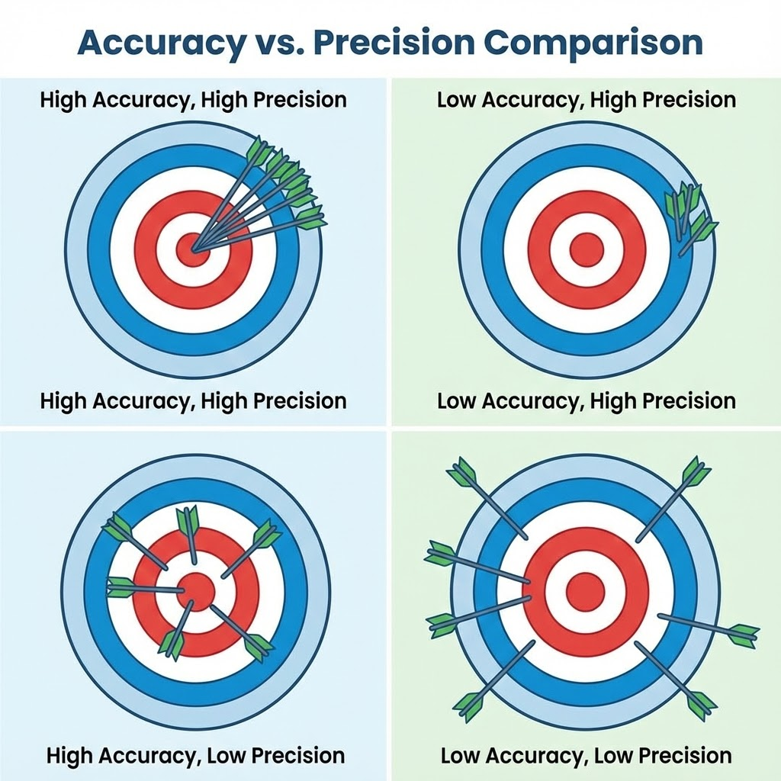

Static Characteristics: Accuracy vs. Precision
A Critical Distinction
In engineering, these are NOT synonyms.
Accuracy: How close the reading is to the true value.
Precision: How close repeated readings are to each other (Repeatability).
Review the target diagram. You can be precise (grouped shots) without being accurate (hitting the bullseye).

Slide 13


Other Static Definitions
Sensitivity
Resolution
The ratio of output change to input change. High sensitivity means detecting small changes easily.
The smallest increment the instrument can detect.
Hysteresis
The difference in output for the same input, depending on whether the input is increasing or decreasing.

Slide 14



Types of Measurement Errors
Errors introduce uncertainty. We must classify them to mitigate them.
Gross Errors
Systematic Errors
Random Errors
Human error. Misreading the scale, calculation mistakes, or incorrect equipment setup.
Instrument bias or environmental effects (e.g., thermal expansion).
Unpredictable noise. Remaining variation after other errors are removed.
Fix: Calibration & Correction factors.
Fix: Training & Checklists.
Fix: Statistical averaging.

Slide 15

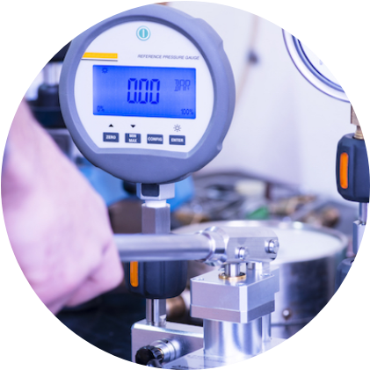
Calibration: The Standard of Truth
The Process
Calibration is the comparison of a device against a standard of higher accuracy.
Traceability: All standards must trace back to national standards (NIST, TBS, etc.).
Frequency: Instruments drift over time. Regular calibration is mandatory for ISO compliance.
Procedure: As shown, a deadweight tester allows precise pressure application to verify gauge readings.

Slide 16
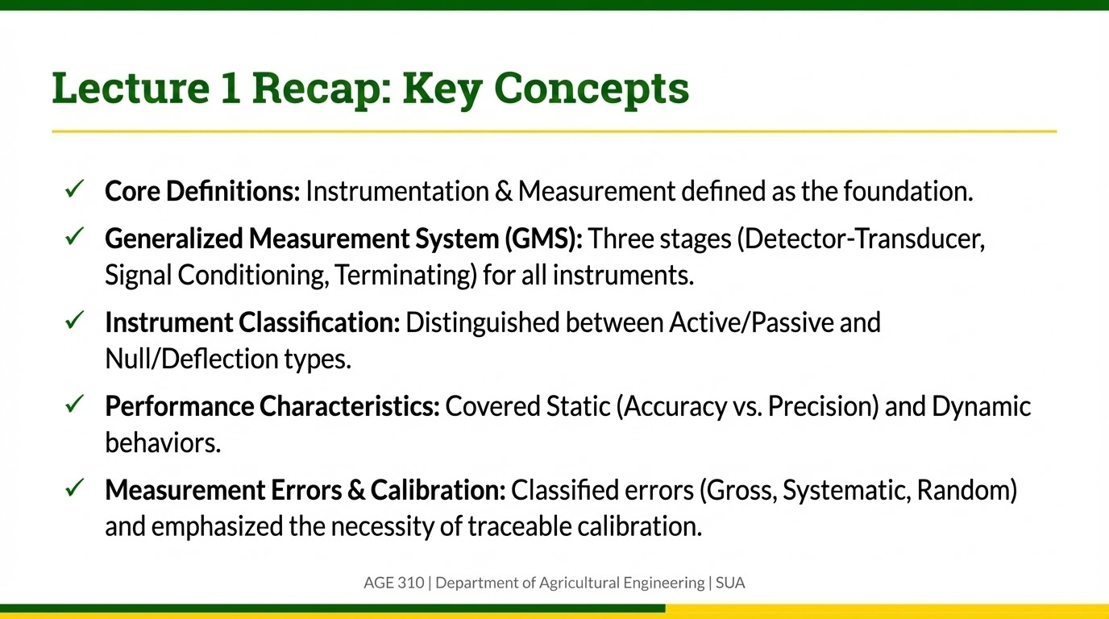

Slide 17

Discussion & Questions
Dr. Kadeghe Fue
Assignment for Next Class:
Identify three measurement instruments in the EPAL Lab and classify them as Active/Passive and Null/Deflection.
AGE 310 | Department of Agricultural Engineering | SUA

